Slide 1

Machine Learning
Lesson 1: Introduction
Machine Learning in the context of Artificial Intelligence

Slide 2
I propose to consider the question:
Can machines think?
Full paper
Notes:
Turing conceived of the universal machine as a means of answering the last of the three questions about mathematics posed by David Hilbert in 1928: (1) is mathematics complete; (2) is mathematics consistent; and (3) is mathematics decidable.

Slide 3
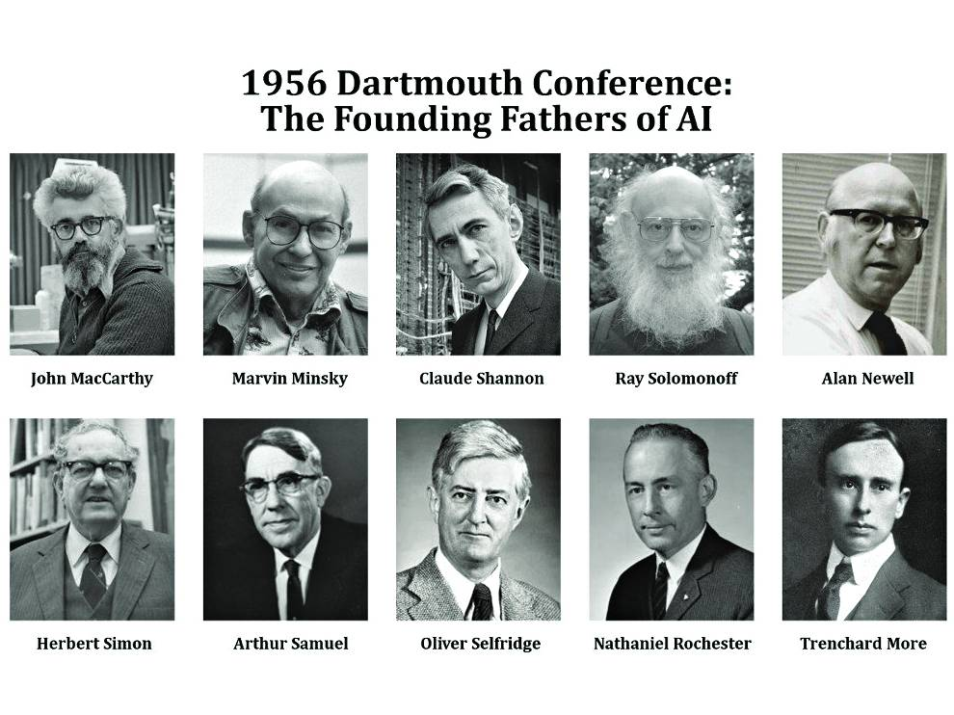
The study is to proceed on the basis of the conjecture that every aspect of learning or any other feature of intelligence can in principle be so precisely described that a machine can be made to simulate it.

Slide 4
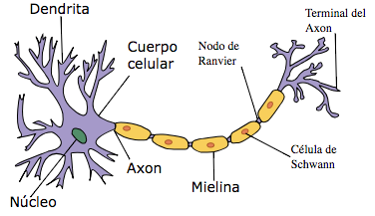
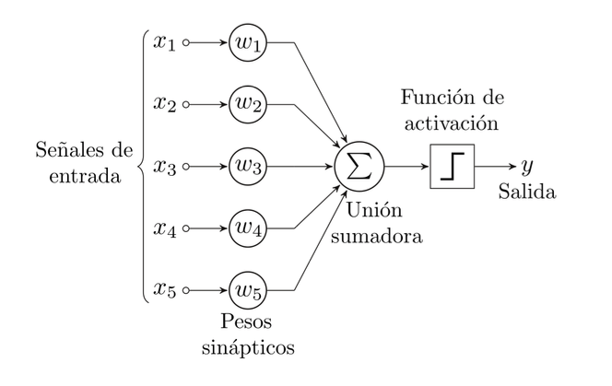

Slide 5
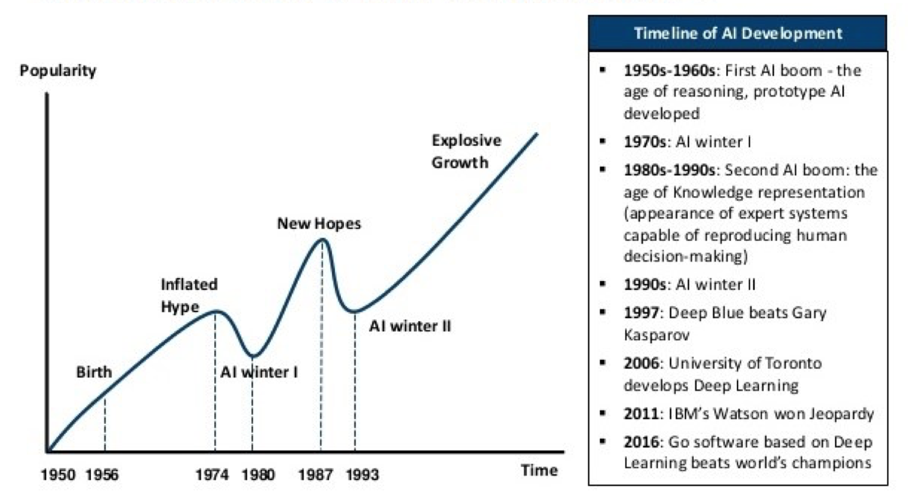

Slide 6
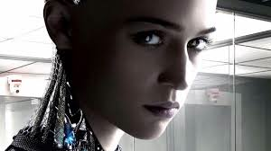
Artificial Intelligence
Definition
A branch of computer science dealing with the simulation of intelligent behavior in computers
The capability of a machine
to imitate intelligent human
behavior

Slide 7
AI technologies
It is a set of rich sub-disciplines and methods (machine learning, pattern recognition, computer vision,…)
We have to consider all these different disciplines and methods in seeking true solutions in delivering value to human beings and organizations
Eric Horvitz (Microsoft Research)

Slide 8
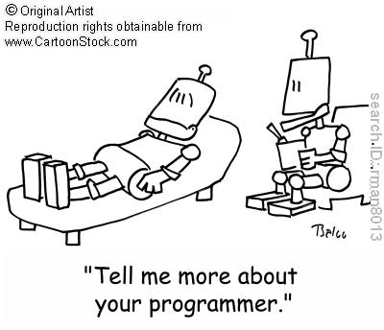
Machine Learning
Definition
Machine learning is a subset of artificial intelligence in the field of computer science that often uses statistical techniques to give computers the ability to "learn" (i.e., progressively improve performance on a specific task) with data, without being explicitly programmed.

Slide 9
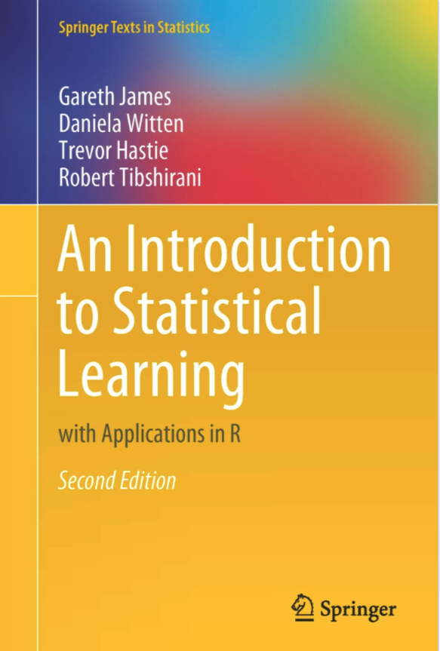


Slide 10
Machine Learning in the context of AI

Slide 11
Machine Learning in the context of AI

Slide 12
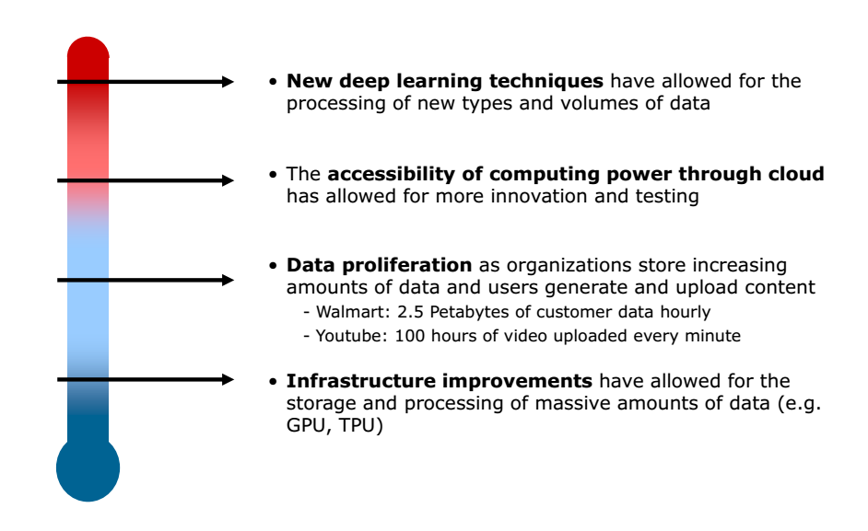
Why now ?
Computational power
cloud computing, hardware (gpu, tpu), availability, cost…
Big data
Over the last years 90 percent of the data in the world was generated.
Democratization of tools:
Open source toolbelt
Wide community adoption
Research and applied research:
Economical value created from AI → more funding → more applications

Slide 13
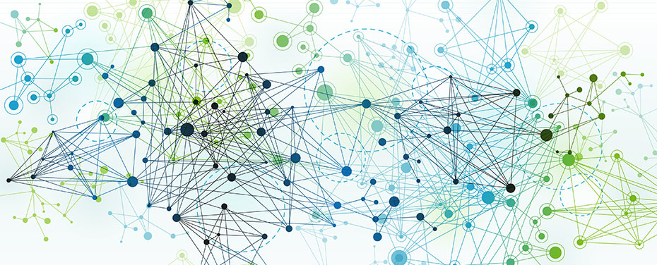
Big data, the big bang

Slide 14


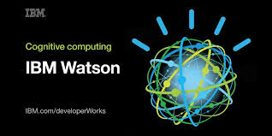


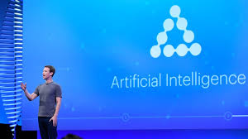


ML expansion: companies

Slide 15
Machine Learning?
Without learning, the agents must be AI programmed during the design. Therefore the machine intelligence depends from the designer and his ability to predict the diversity of the environment and its possible changes
It is possible?

Slide 16
ML formalization
A computer program is said to learn from experience E with respect to some class of tasks T and performance measure P, if its performance at tasks in T, as measured by P, improves with experience E.
Tom Mitchell (CMU, 1998)

Slide 17
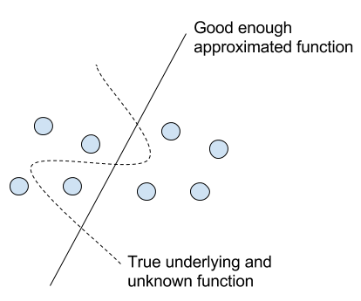
Se dice de un programa que aprende de la experiencia E con respecto a la tarea T y una medida de rendimiento P si el rendimiento P sobre T aumenta con la experiencia E
T. Mitchel, 1997
Campo de estudio que da a los ordenadores la capacidad de aprender sin ser programados de forma específica
A. Samuel, 1959
Podemos entender un algoritmo de ML como un algoritmo que cambia su estado interno para encontrar el major mapeo entre una variable de salida y sus características de entrada

Slide 18
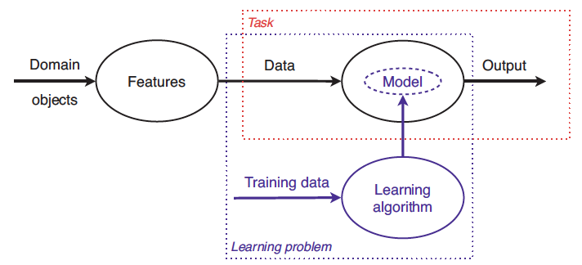
Task: machine learning model
Allows the mapping between data and output, and it is found by computational learning algorithms

Slide 19
Task: defining the problem
Example: Gender recognition
male
female

Slide 20
Dataset (Experience)

Slide 21
Performance
Classification Task

Slide 22
Training
updating model…
updating model…
updating model…
updating model…
updating model…
updating model…
updating model…
female
male
male
female
female
male

Slide 23
Testing
Testing: (probability)
This is a female ( 98% sure)
?
?

Slide 24
Testing
Testing (Performance)
This is a male ( 70% sure)
?
?

Slide 25
A more detailed example… https://playground.tensorflow.org/

Slide 26
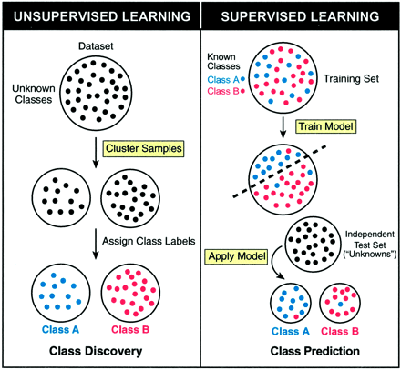
Learning main types
Supervised
Data is provided (through a "master") as pairs of cases-labels, indicating whether or not they belong to the type of association to be learned (classification, regression). Practical case: prediction
Unsupervised
The algorithm must use other funds to obtain a "feedback" that tells him whether he does it well or not, since he does not have a "master” (clustering). Practical case: segmentation

Slide 27
Task types
Classification
Classification algorithms are used when the desired output is a discrete label.
Regression
Approximate a continuous function (predicting outputs that are continuous)

Slide 28
Computational learning: training
Learning from data

Slide 29
Model.train
Dataset
Learning algorithm
Model
inputs
predictions

Slide 30
Model.predict
Dataset
Learning algorithm
AI / ML system
Model
inputs
predictions

Slide 31
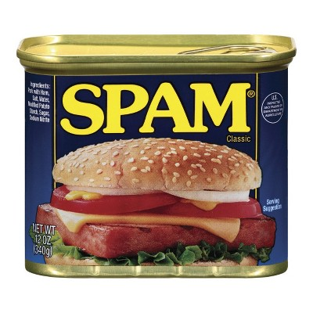
Why ML ?
Imaginemos que queremos construir un filtro de spam.
Como diseñaríais un programa que detectase si un mail es spam o no?

Slide 32
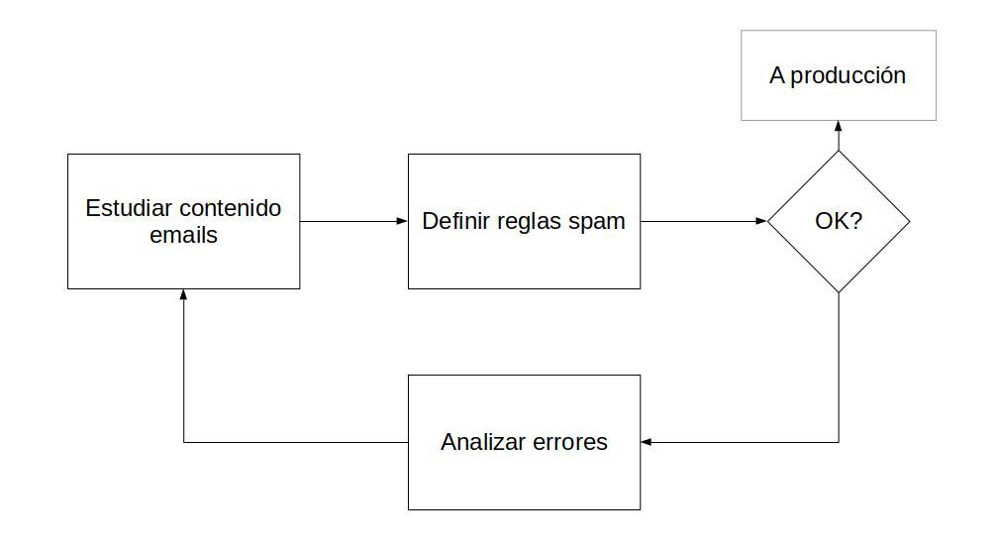
Why ML ?
Aproximación tradicional…
Estudiar contenido de los emails
Definir reglas en base a expresiones regulares
Crear una lista negra de ips
Crear una lista negra de ”spammers”

Slide 33
Why ML ?
Pero...
Los spammers se pueden adaptar...
..las reglas cambiar...
...obligarnos a iterar sobre los distintos pasos del sistema montado...
...con la contra de que, aparte de consumir mucho tiempo, el sistema se vuelve inmantenible.

Slide 34


Slide 35
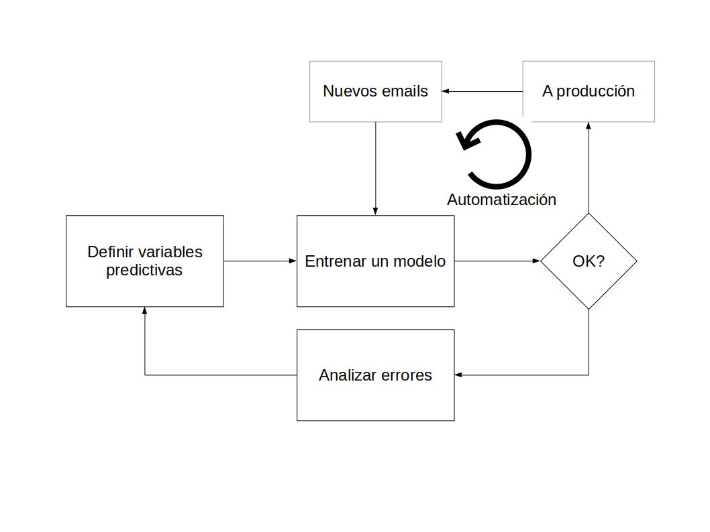
The ML way
Si en vez de intentar definir las reglas a mano cada vez que queramos modificar nuestro sistema de detección de spam utilizamos un clasificador, podemos redefinir el problema como
Estudiar el problema desde el punto de vista de que variables me afectan a que sea spam
por ejemplo patrones de palabras frecuentes en emails normales o spam (bag of words, tf-idf)
Entrenar un clasificador sobre las variables seleccionadas:
e.g. naive-bayes, logistic regression...

Slide 36
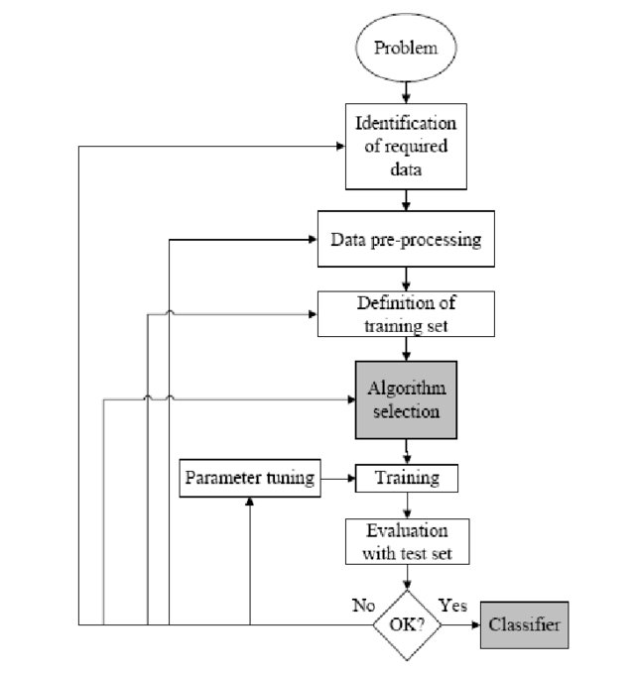
How to develop a ML solution
Framing the problem:
From Real world problem to ML problem
Getting the data
Do I have data to solve this problem?
Explore the data
Is the data representative?
Train and select the model
Model selection and feature engineering
Deploy
How it will be consumed?

Slide 37
When ML ?
Los sistemas de ML son buenos para:
Problemas que requieren mucho trabajo manual o largas listas de reglas
Entornos que evolucionan
Conseguir insights en datos complejos

Slide 38
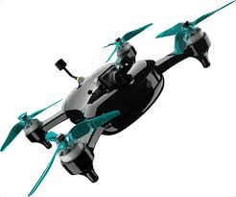
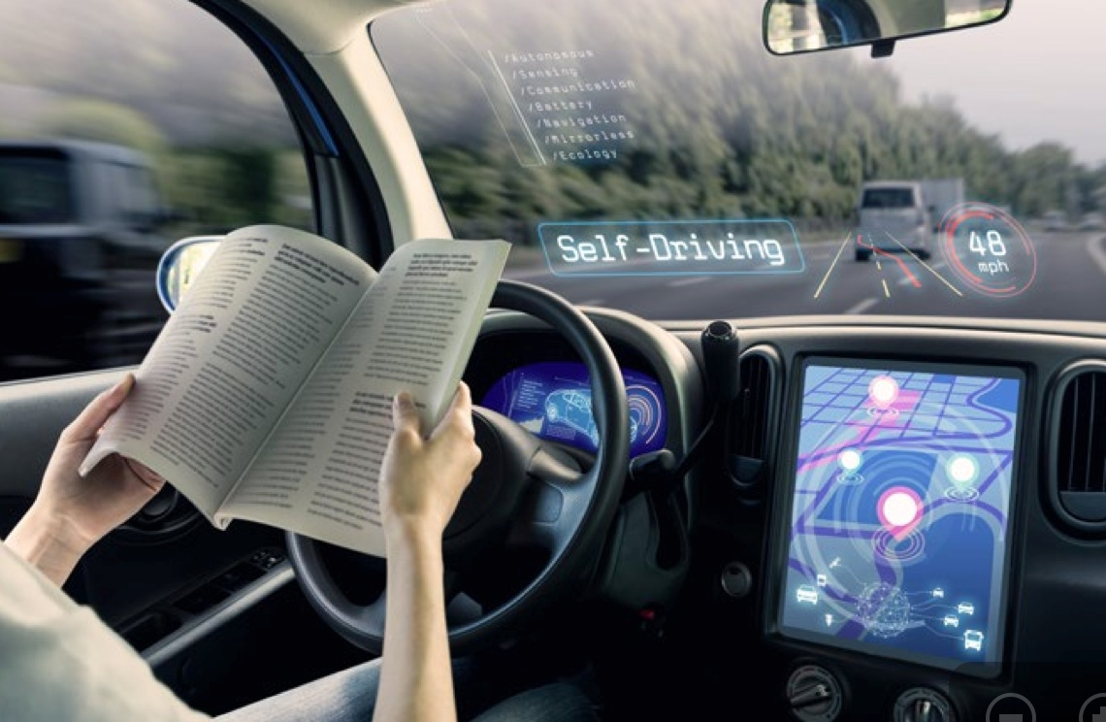

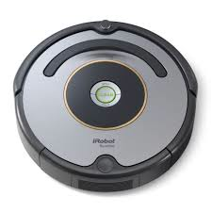
Real world applications
CARS
HEALTH
ROBOTICS
Self-driving cars will be in place by the end of the next decade, 2030.
Genetic research, medical assistance, and personalized treatments.
Autonomous robots to assist people.

Slide 39
Ethics!
The purpose specification
Limitations of data: bias
Limitations of data: privacy
Autonomous?
Education
People: Explainable AI

Slide 40
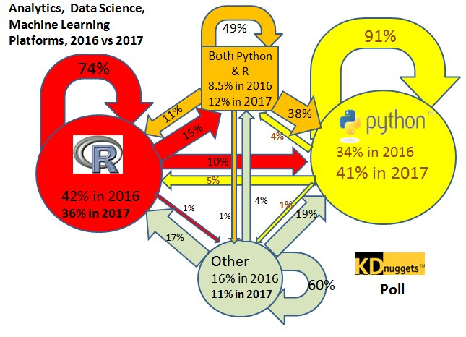
Python for data science and ML
Python es un lenguaje de programación interpretado cuya filosofía hace hincapié en una sintaxis que favorezca un código legible.
Como cualquier otra matería prima, el dato debe pasar por una serie de etápas y transformaciones desde que es "extraído" (APIs, scrapping, encuestas...) hasta que es "consumido" (aplicaciones, sistemas de recomendación, ...)

Slide 41
Python for data science and ML
Although GitHub has traditionally been home to software developers, the world’s code is evolving. Behind Python’s growth is a speedily-expanding community of data science professionals and hobbyists—and the tools and frameworks they use every day. These include the many core data science packages powered by Python that are both lowering the barriers to data science work and proving foundational to projects in academia and companies alike.
Beyond Python, repositories with topics like “deep learning”, “natural language processing”, and “machine learning” have become more popular over the years with growing communities focused on data science. Among the most popular (based on star counts) public repositories labelled with the topic, over half of them are built on numpy, and many of them depend on scipy, scikit-learn, and TensorFlow. We’ve also seen non-code contributions from the data science field, including academic papers.
source

Slide 42
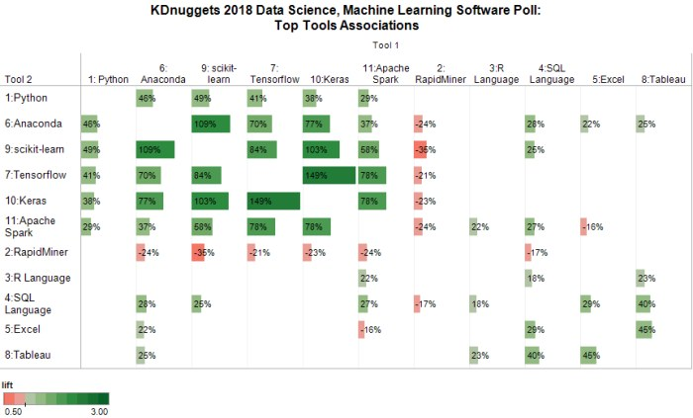
Python for data science and ML
6 primary tools that together make the modern open source data science ecosystem: Python, Anaconda, scikit-learn, Tensorflow, Keras, and Apache Spark.

Slide 43
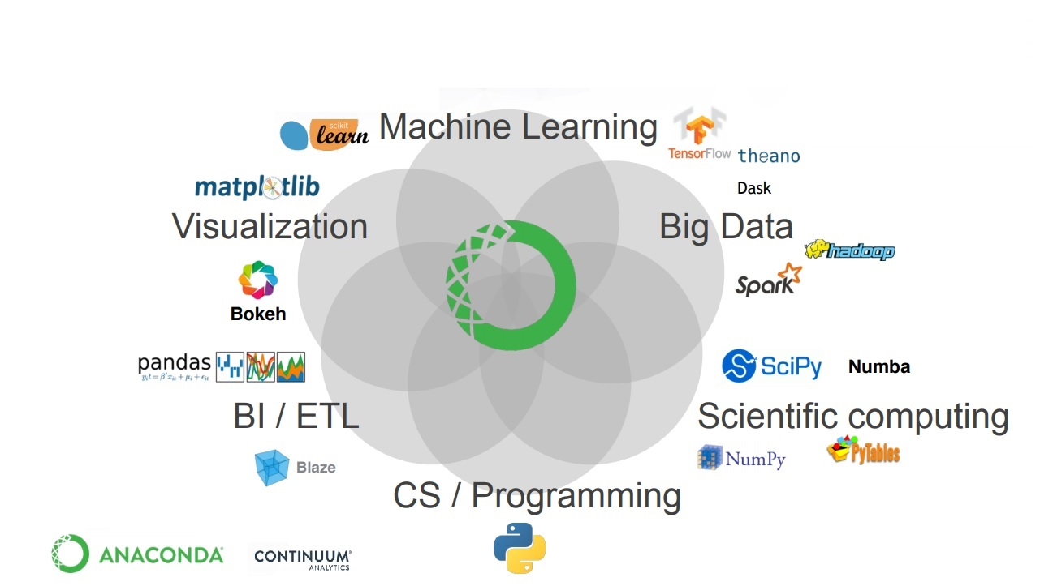
Python for data science and ML

Slide 44
To do…
Create github account:
where code happens
Own portfolio
Code repository
Install data science working environment:
Anaconda installation (easiest way: bundled and curated list of libraries for data science and python development)

